Slide 1
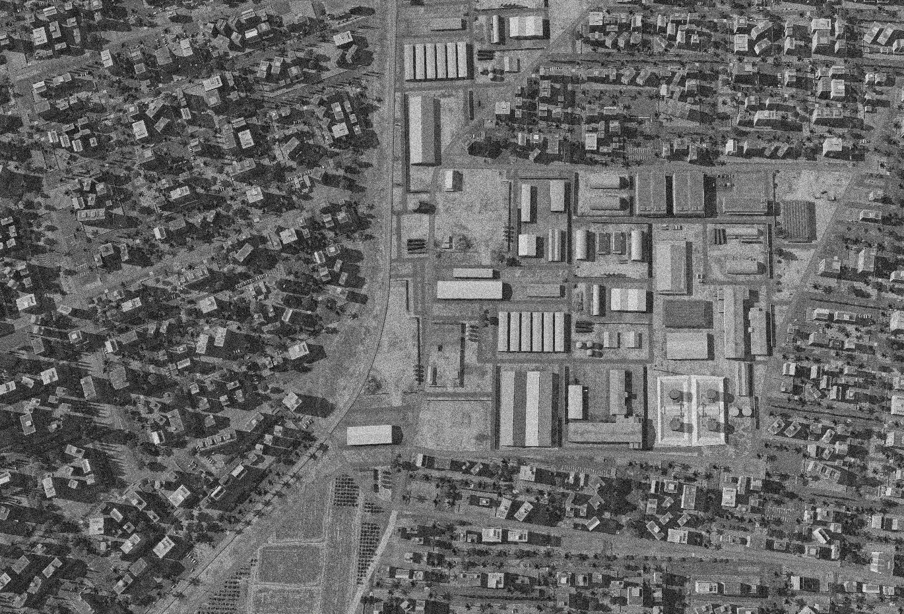

SYTGT010 HOMS AMMUNITION FACTORY
N
11A/B
08
13
14
12A/B
10
7
9
6
4
5
8
DESIRED POINT of IMPACT:
DPI 14 - N34 43.174 E 36 42.570 / 1652ft / 500lb PGM
DPI 13 - N34 43.183 E 36 42.522 / 1653ft / 2000lb PGM
DPI 12B - N34 43.190 E 36 42.478 / 1648ft / 2000lb PGM
DPI 12A - N34 43.190 E 36 42.463 / 1648ft / 2000lb PGM
DPI 11B - N34 43.190 E 36 42.443 / 1644ft / 2000lb PGM
DPI 11A - N34 43.190 E 36 42.429 / 1644ft / 2000lb PGM
DPI 10 - N34 43.144 E 36 42.323 / 1638ft / 500lb PGM
DPI 9 - N34 43.106 E 36 42.273 / 1637ft / 500lb PGM
DPI 8 - N34 43.089 E 36 42.514 / 1660ft / 500lb PGM
DPI 7 - N34 43.133 E 36 42.458 / 1650ft / 500lb PGM
DPI 6 - N34 43.104 E 36 42.419 / 1652ft / 500lb PGM
DPI 5 - N34 43.078 E 36 42.348 / 1647ft / 500lb PGM
DPI 4 - N34 43.078 E 36 42.317 / 1645ft / 500lb PGM
DPI 3 - N34 43.004 E 36 42.402 / 1661ft / 500lb PGM
DPI 2 - N34 43.016 E 36 42.344 / 1647ft / 500lb PGM
DPI 1 - N34 43.016 E 36 42.321 / 1647ft / 500lb PGM
1
2
3
CDC - High density civilian housing within 20m of facility to the N, E and South. Approx 100m to the West. Chemical precursors within complex (in red) pose high risk of pollution to civilian population if destroyed.

Slide 2
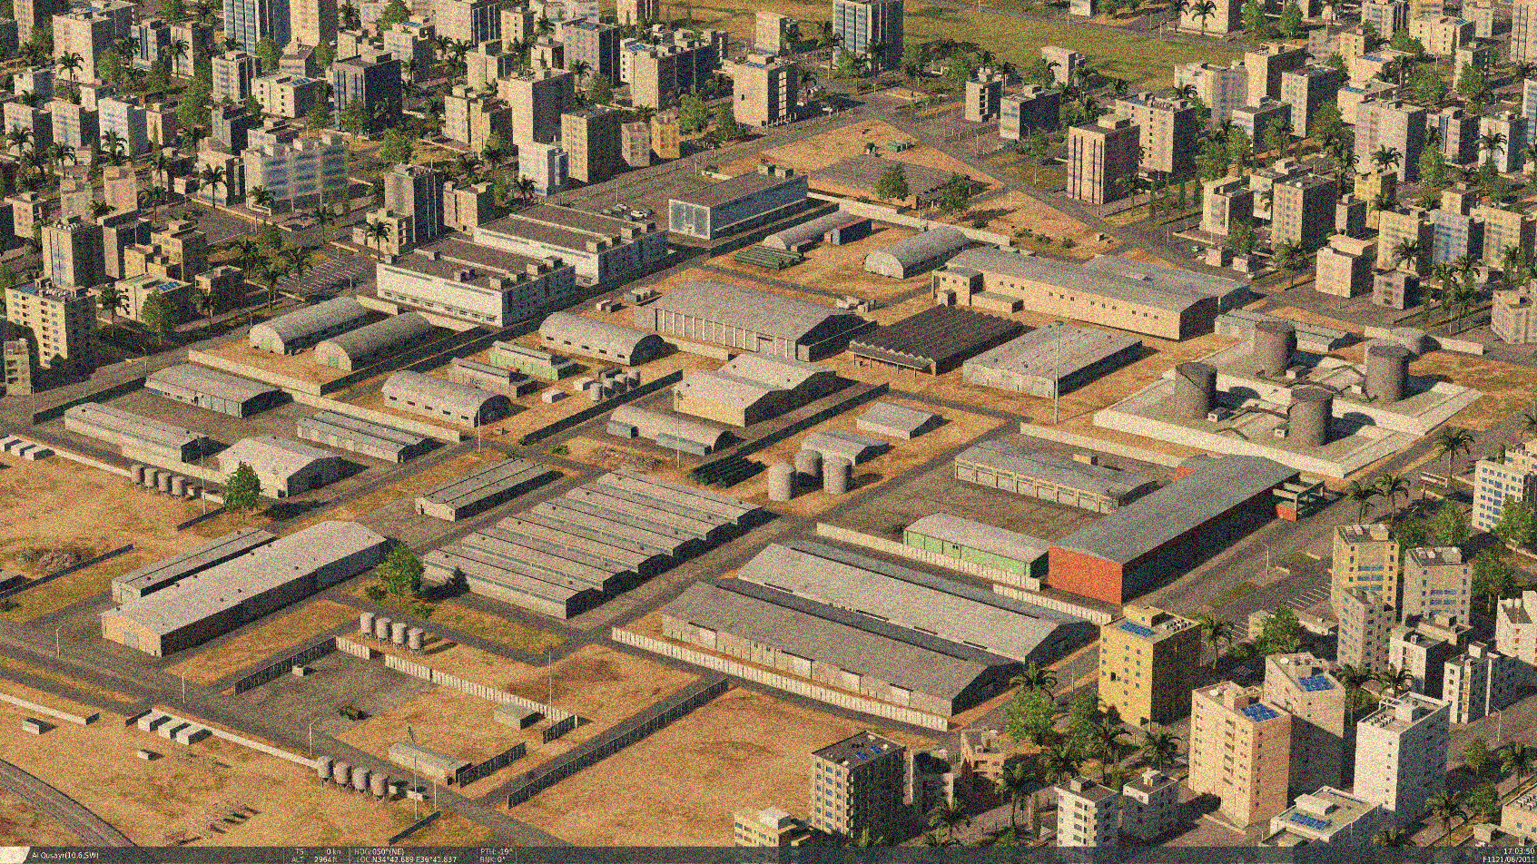
OPARTGT010 HOMS AMMUNITION FACTORY
Administration Building
N
Known to be producing a-g rockets which includes MSLR artillery rockets.
The facility is embedded within a highly dense civilian population and thus poses significant CDC.
The assembly buildings are made of reinforced concrete which require at least a 2000lb bomb.
Storage facility
N
Assembly Buildings
Assembly Building
Chemical precursor tanks
Storage tanks
Logistical Support Buildings
Storage facilities
Storage facilities
CDC - High density civilian housing within 20m of facility to the N, E and South. Approx 100m to the West. Chemical precursors within complex (in red) pose high risk of pollution to civilian population if destroyed.

